Slide 1

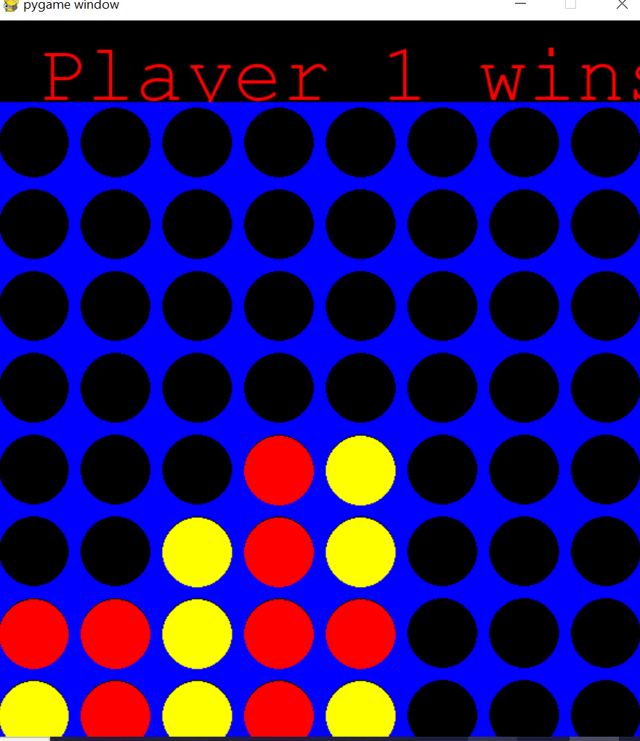

Multiplayer Connect X
Codded by:
Aaron Macdonald
Introducing a multiplayer customizable Connect 4 experience.

